Slide 1

Pós-graduação Big Data & Decision Making 23/24
Renewable Data Rangers
Nelson Moreira
1070792
Software Engineer
Tiago Reis
1140599
Data Engineer

Slide 2





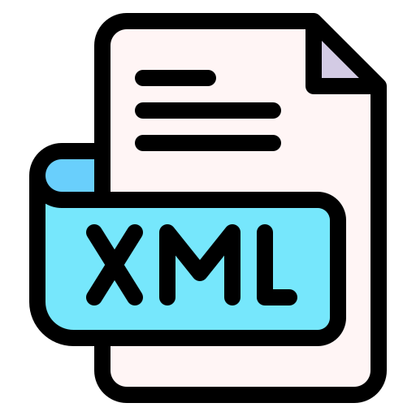

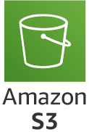

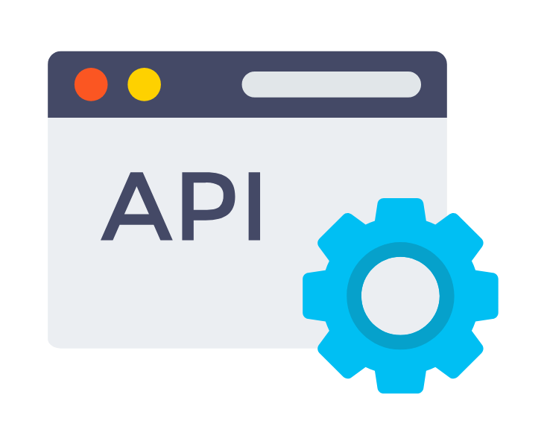






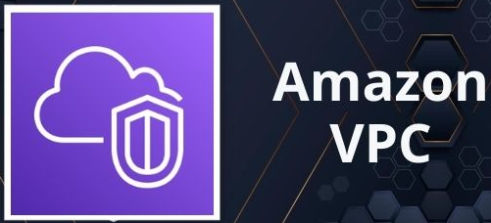

Batch Architecture
Serving Layer
Could native & scalable & collaborative
Storage Layer
Data Sources
Ingestion Layer
AI/ML
Raw Storage/Backup
Data Warehouse
Bronze layer
(CSV
JSON)
Silver Layer
(Parquet)
Gold Layer
(Parquet)
Analytics/Visualization
Orchestration
Security
Monitoring

Slide 3
Batch Architecture
Serving Layer
Could native & scalable & collaborative
Storage Layer
Data Sources
Ingestion Layer
AI/ML
Raw Storage/Backup
Data Warehouse
Bronze layer
(CSV
JSON)
Silver Layer
(Parquet)
Gold Layer
(Parquet)
Analytics/Visualization
Orchestration
Security
Monitoring

Slide 4




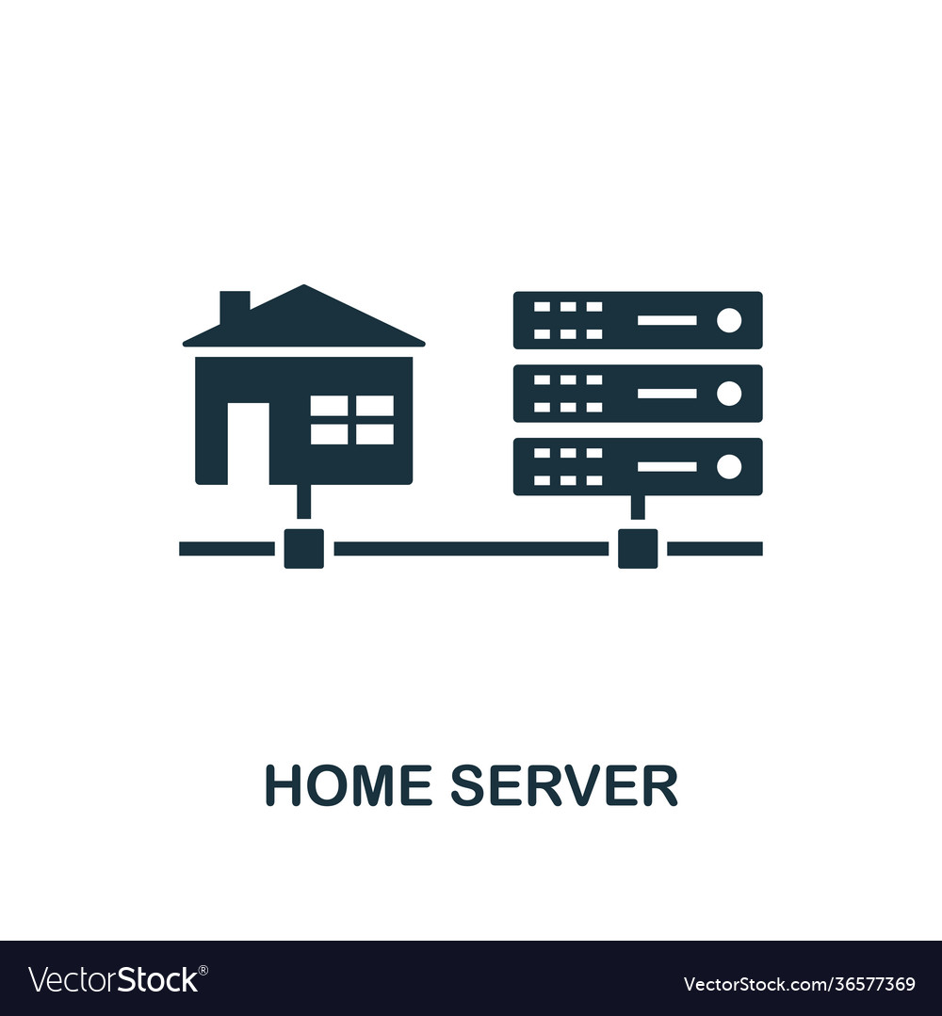
Batch Architecture
Serving Layer
Could native & scalable & collaborative
Storage Layer
Data Sources
Ingestion Layer
AI/ML
Logs
Data Warehouse
Bronze layer
(Parquet)
Silver Layer
(Parquet)
Gold Layer
(Parquet)
Data Lake
Analytics/Visualization
Orchestration

Slide 5






Batch Architecture
Serving Layer
Could native & scalable & lower-cost
Storage Layer
Data Sources
Ingestion Layer
Exploration/ML
OLTP
Data Warehouse
Bronze layer
(CSV
JSON)
Silver Layer
(Parquet)
Gold Layer
Analytics/Visualization
Orchestration
Security
Monitoring
Ops control

Slide 6
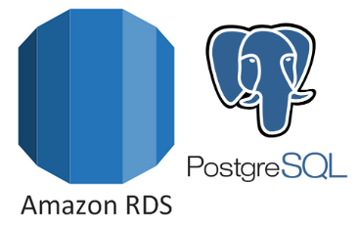

Batch Architecture
Serving Layer
No cost & dev environment
Storage Layer
Data Sources
Ingestion Layer
Exploration/ML
OLTP
Data Warehouse
Raw Storage/Backup
CSV/JSON
Bronze layer
Silver Layer
Gold Layer
Analytics/Visualization
Orchestration
Security
Monitoring
Ops control

Slide 7
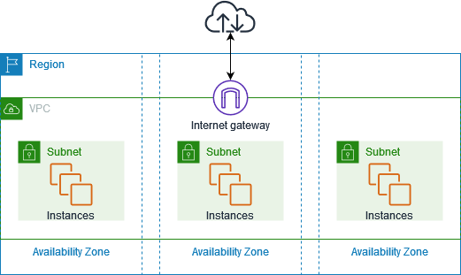


Amazon Virtual Private Cloud (Amazon VPC)
Ingestion Layer
Orchestration Layer
Serving Layer
Storing Layer

Slide 8



Batch Architecture
Storage Layer
Serving Layer
CSV/JSON
Raw Storage/Backup
Data Sources
Data Sources
Ingestion Layer
Exploration/ML
OLTP
Data Warehouse
Bronze layer
Silver Layer
Gold Layer
Analytics/Visualization
Prod tool:
Dev Alternative:
Orchestration
Security
Monitoring
Ops control

Slide 9
Pós-graduação Big Data & Decision Making 23/24
Renewable Data Rangers
"O produto somos nós!"
https://rdatarangers.blogspot.com/
https://github.com/Tiago-B-C-Reis/RenewableDataRangers/tree/main?tab=readme-ov-file
Obrigado

Slide 10
AI SP-500

Slide 11

Batch Architecture
Storage Layer
Serving Layer
Exploration/ML
Data Sources
Ingestion Layer
OLTP
Data Warehouse
Bronze layer (Raw Data + backup)
Silver Layer
Gold Layer
Analytics/Visualization
Orchestration
Containerization
Security
Monitoring
Ops control

